Slide 1
Functions and Recursion

Slide 2
Function: A named sequence of statements that performs some useful operation. Functions may or may not take arguments and may or may not produce a result.
Function definition: A statement that creates a new function, specifying its name, parameters, and the statements it executes.
Function call: A statement that call a function definition to perform a specific task.

Slide 3
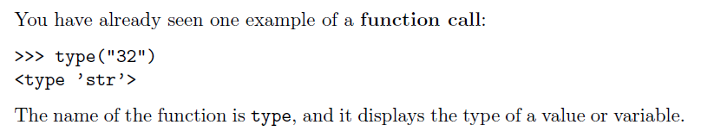
Function calls

Slide 4
>>> type(“32”)
Function Name
Arguments
<type ‘str’>
Return Value
Notes:
So ,Guys how many of you are afraid of programming ???? , who think that coding is the most difficult thing to do ??? Pick one of them and ask him/her the recipe of Maggi or tea …

Slide 5
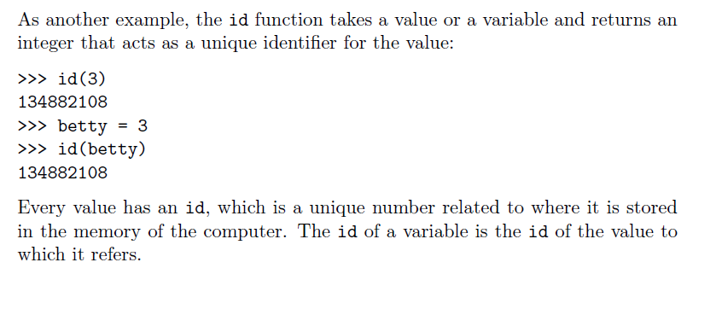

Slide 6
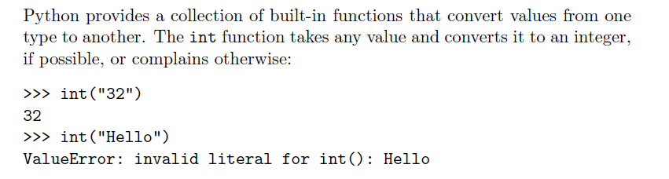
Type conversion

Slide 7
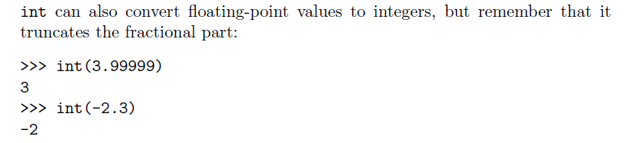
Float to integer conversion

Slide 8
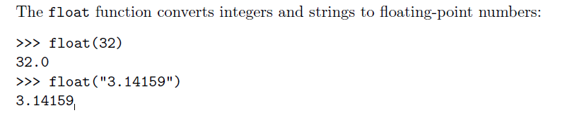
Integer and String Conversion to Float
Notes:
We all know YouTube as the place to upload cat videos and fails. As one of the most popular websites in existence, it provides us with endless hours of video entertainment. The Python programming language powers it and the features we love.

Slide 9
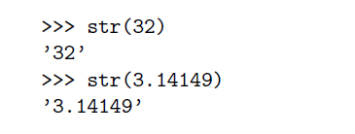
Integer and Float Conversion to String
Notes:
DropBox started the online document storing revolution that has become part of daily life. We now store almost everything in the cloud. Dropbox allows us to store, sync, and share almost anything using the power of Python.

Slide 10
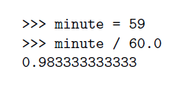
Type coercion
Rules for automatic type conversion is know as Type coercion.
For example,
By making the denominator or numerator a float, we force Python to do floating-point division.
Notes:
Survey Monkey is the largest online survey company. They can handle over one million responses every day on their rewritten Python.

Slide 11
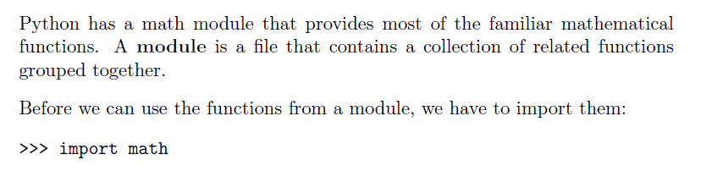
Math Functions
Notes:
Python also provides the power behind the most popular search engine in the world – Google. The programming language can handle the traffic and computing needs of the search engine and its connected apps.

Slide 12
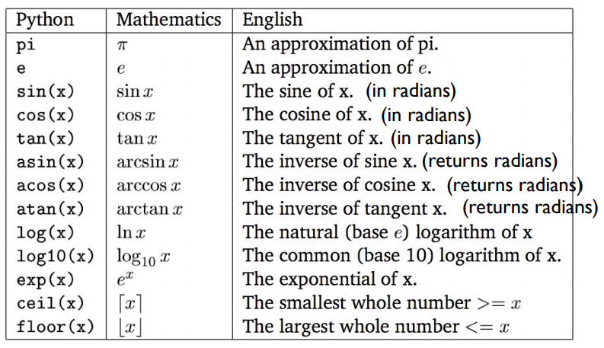
sqrt(x) = square root

Slide 13
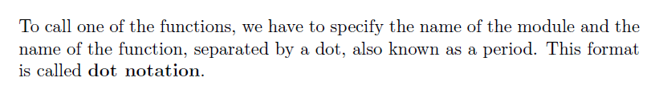
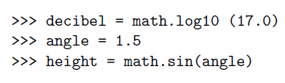
Calling a Math Function
For Example,
Notes:
Quora is the number one place online to ask a question and receive answers from a community of individuals. On their Python website relevant results are answered, edited, and organized by these community members.

Slide 14
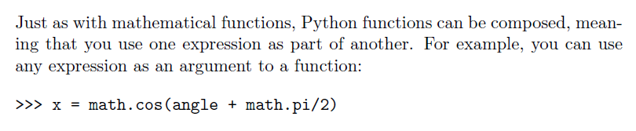
Composition
Notes:
A majority of the code for Bitly URL shortening services and analytics are all built
with Python. Their service can handle hundreds of millions of events per day.

Slide 15
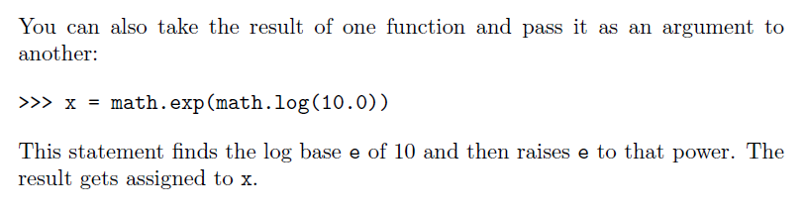
Composition
Notes:
Reddit is known as the front page of the internet. It is the place online to find information or entertainment based on thousands of different categories. Posts and links are user generated and are promoted to the top through votes. Many of Reddit’s capabilities rely on Python for their functionality.

Slide 16
Mathematical functions
abs(x) : calculates the absolute value of x
pow(x , y) : calculates x raise to the power of y.
max (x1,x2….xn) : Gives the maximum number out the all the given numbers in parenthesis.
min (x1,x2…xn) : Gives the minimum number out the all the given numbers in parenthesis.

Slide 17
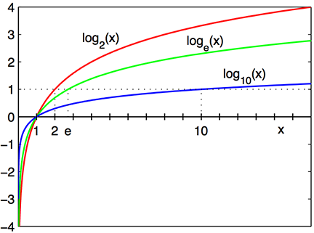
e= 2.718281828459

Slide 18
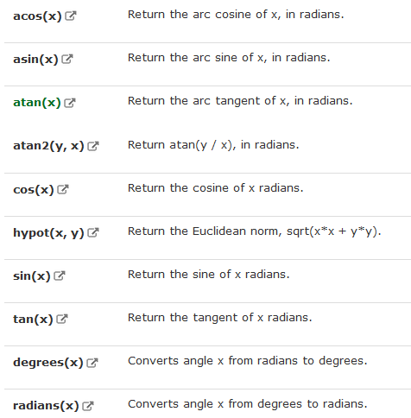
Trigonometric Functions in Math Module

Slide 19

Adding new or user defined functions
A function is a named sequence of statements that performs a desired operation. This operation is specified in a function definition.
The syntax for a function definition is:
Notes:
Yahoo maps may be losing the battle to other map service providers, but it still holds some powerful tools. Yahoo’s map program runs on Python as well as many of its other programs.

Slide 20
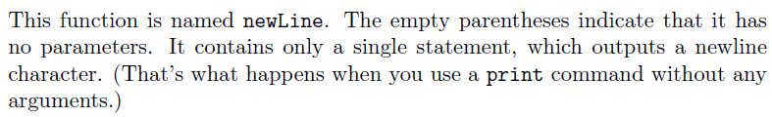
Example,
def newLine():
print()
Notes:
So now lets start with Python …..For your better Future.
You can be placed in one of these companies ,if you are expert in python. You don’t need to approach them , then they will approach you.

Slide 21
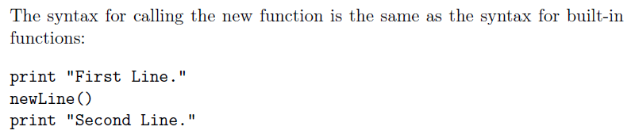

Calling user defined functions
Output of the program is:

Slide 22
Why do we need to create functions?
Creating a new function gives you an opportunity to name a group of statements. Functions can simplify a program by hiding a complex computation behind a single command and by using English words in place of arcane code.
Creating a new function can make a program smaller by eliminating repetitive code.

Slide 23
Few points to remember
Only the function definition generates no output.
The statements inside the function do not get executed until the function is called.
You have to create a function before you can execute it.
Docstrings The first string after the function header is called the docstring and is short for documentation string. It is briefly used to explain what a function does.

Slide 24
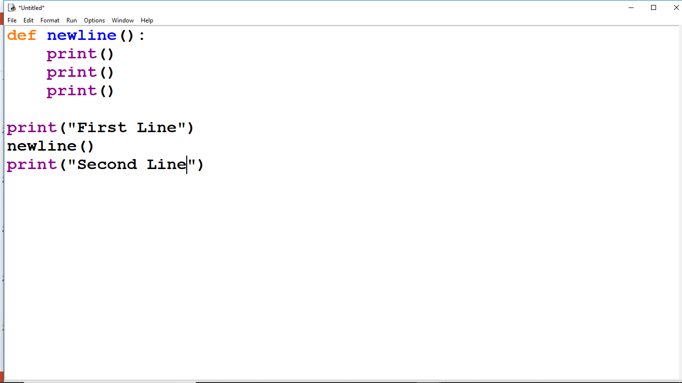
Flow of execution
In order to ensure that a function is defined before its first use, you have to know the order in which statements are executed, which is called the flow of execution.
3
4
5
6
1
Execution Starts
2
7

Slide 25
Parameters and arguments
Arguments are the values that control how the function does its job.
For example, if you want to find the sin of a number, you have to indicate what the number is. Thus, sin takes a numeric value as an argument.
Some functions take more than one argument. For example, pow takes two arguments, the base and the exponent. In the function definition, the values that are passed get assigned to variables called as parameters.

Slide 26
EXAMPLE
def addme( num1, num2):
mysum = num1+num2
return mysum
x=10
y = 12
addme(x, y)
# Here x and y are arguments
# num1 and num2 are parameters

Slide 27
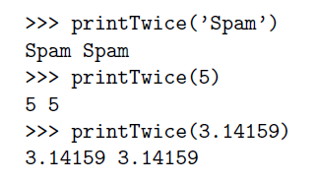
def printTwice(twice):
print(twice, twice)
Function Definition
with arguments
Function Call
with arguments of
type String, Integer
and float respectively

Slide 28
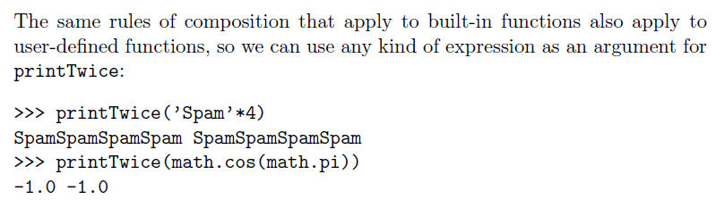
Composition for user defined functions

Slide 29
Variables and parameters are local
When you create a local variable inside a function, it only exists inside the function, and you cannot use it outside. For example:
def catTwice(part1, part2):
cat = part1 + part2
print (cat)
>>> a= “Python”
>>> b=“Class”
>>> catTwice(a,b)

Slide 30
When cat Twice terminates, the variable cat is destroyed. If we try to print it,
we get an error:
>>> print( cat)
NameError: cat
Parameters are also local. For example, outside the function catTwice(part1, part2), there is no such thing as part1 and part2

Slide 31
Quiz what would be the output for following code sum,i=0,0 while i<7: print(i+2) sum=sum+i print(“I am out of loop”) print(sum)
I am out of loop
10
3
4
5
6
7
I am out of loop
10
C. 3
4
5
6
7
D. Error

Slide 32
Stack Diagram for functions
To keep track of which variables can be used where, it is sometimes useful to draw a stack diagram.
Stack diagram is used to represent the state of a program during a function call.
Each function is represented by a frame. A frame is a box with the name of a function beside it and the parameters and variables of the function inside it.

Slide 33
a “Python”
b “Class”
_main_
catTwice
Part1 “Python”
Part2 “Class”
Cat “Python Class”

Slide 34
Functions with results
def mul (x,y):
return x*y
>>> a=mul(3,4)
>>> print(a)
12

Slide 35
Recursion
It is legal for one function to call another, and you have seen several examples of that.
But it is also legal for a function to call itself.
A function is called a recursive function if it calls itself again and again . Recursion can be direct as well as indirect. Direct recursion is when a function calls itself. Whereas indirect recursion is when a function calls another function and the called function in turn calls the calling function.

Slide 36
Recursion
A function is called a recursive function if it calls itself again and again . Recursion can be direct as well as indirect. Direct recursion is when a function calls itself. Whereas indirect recursion is when a function calls another function and the called function in turn calls the calling function.
A
B
C
C()
A()
B()

Slide 37
Recursion
def countdown(n):
if n==0:
print("blastoff")
else:
print(n)
countdown(n-1)

Slide 38
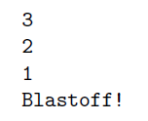
>>> countdown(3)
OUTPUT of this function will be :
Notes:
The execution of countdown begins with n=3, and since n is not 0, it outputs the value 3, and then calls itself...The execution of countdown begins with n=2, and since n is not 0, it outputs the value 2, and then calls itself...
The execution of countdown begins with n=1, and since n
is not 0, it outputs the value 1, and then calls itself...
The execution of countdown begins with n=0, and
since n is 0, it outputs the word, \Blasto!" and
then returns.
The countdown that got n=1 returns.
The countdown that got n=2 returns.
The countdown that got n=3 returns.
And then you're back in main

Slide 39
Stack diagrams for recursive functions
Earlier we used a stack diagram to represent the state of a program during a function call. The same kind of diagram can help interpret a recursive function.
Every time a function gets called, Python creates a new function frame, which contains the function's local variables and parameters. For a recursive function, there might be more than one frame on the stack at the same time.

Slide 40
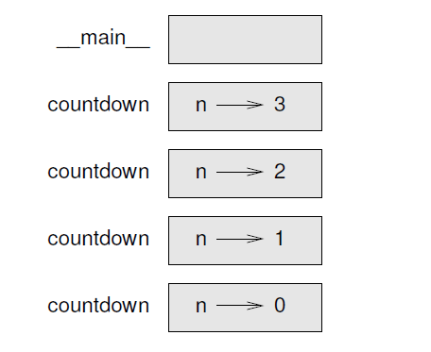
Following figure shows a stack diagram for function countdown (n) called with n = 3:
Notes:
The top of the stack is the frame for __main__ . It is empty because we did not create any variables in main or pass any arguments to it.

Slide 41
Infinite recursion
If a recursion never reaches a base case, it goes on making recursive calls forever, and the program never terminates. This is known as infinite recursion, and it is generally not considered a good idea. Here is a minimal program with an infinite recursion:
def recurse () :
recurse()
Function is calling
itself without any
condition to terminate
The recursive call

Slide 42
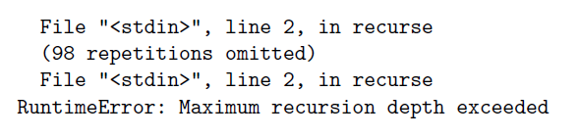
In most programming environments, a program with infinite recursion does not really run forever. Python reports an error message when the maximum recursion depth is reached:

Slide 43
Quiz
The output for the following program would be
import math
X=6
if X>0:
print(math.log10())
else:
print(“I am in else”)
A. 1.4567 B. I am in else C. No out put D. Error

Slide 44
EXCERCISE
Write a Python function to find the Max of three numbers.
Write a Python function to sum all the numbers in a list.
Write a Python function to multiply all the numbers in a list.
Write a Python function to reverse a string.
Write a Python function to calculate the factorial of a number (non-negative integer). The function accept the number as an argument.

Slide 45
6. Write a Python function to check whether a number is in a given range.
7. Write a Python function that takes a number as a parameter and check the number is prime or not.
8. Write a Python function that checks whether a passed number is palindrome or not.

Slide 46
9. Write a Python function to check whether a number is perfect or not. According to Wikipedia : In number theory, a perfect number is a positive integer that is equal to the sum of its proper positive divisors, that is, the sum of its positive divisors excluding the number itself (also known as its aliquot sum). Equivalently, a perfect number is a number that is half the sum of all of its positive divisors (including itself). Example : The first perfect number is 6, because 1, 2, and 3 are its proper positive divisors, and 1 + 2 + 3 = 6. Equivalently, the number 6 is equal to half the sum of all its positive divisors: ( 1 + 2 + 3 + 6 ) / 2 = 6. The next perfect number is 28 = 1 + 2 + 4 + 7 + 14. This is followed by the perfect numbers 496 and 8128.

